Slide 1
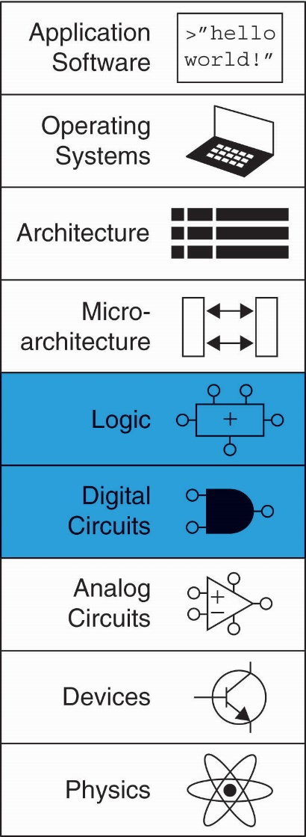
Chapter 4 :: Topics
Introduction
Combinational Logic
Structural Modeling
Sequential Logic
More Combinational Logic
Finite State Machines
Parameterized Modules
Testbenches

Slide 2
Introduction
Hardware description language (HDL):
specifies logic function only
Computer-aided design (CAD) tool produces or synthesizes the optimized gates
Most commercial designs built using HDLs
Two leading HDLs:
SystemVerilog
developed in 1984 by Gateway Design Automation
IEEE standard (1364) in 1995
Extended in 2005 (IEEE STD 1800-2009)
VHDL 2008
Developed in 1981 by the Department of Defense
IEEE standard (1076) in 1987
Updated in 2008 (IEEE STD 1076-2008)

Slide 3
HDL to Gates
Simulation
Inputs applied to circuit
Outputs checked for correctness
Millions of dollars saved by debugging in simulation instead of hardware
Synthesis
Transforms HDL code into a netlist describing the hardware (i.e., a list of gates and the wires connecting them)

Slide 4
HDL to Gates
Simulation
Inputs applied to circuit
Outputs checked for correctness
Millions of dollars saved by debugging in simulation instead of hardware
Synthesis
Transforms HDL code into a netlist describing the hardware (i.e., a list of gates and the wires connecting them)
IMPORTANT: When using an HDL, think of the hardware the HDL should produce

Slide 5
SystemVerilog Modules
Two types of Modules:
Behavioral: describe what a module does
Structural: describe how it is built from simpler modules

Slide 6
Behavioral SystemVerilog
SystemVerilog:
module example(input logic a, b, c,
output logic y);
assign y = ~a & ~b & ~c | a & ~b & ~c | a & ~b & c;
endmodule

Slide 7
Behavioral SystemVerilog
SystemVerilog:
module example(input logic a, b, c,
output logic y);
assign y = ~a & ~b & ~c | a & ~b & ~c | a & ~b & c;
endmodule
module/endmodule: required to begin/end module
example: name of the module
Operators:
~: NOT
&: AND
|: OR

Slide 8
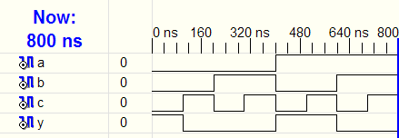
HDL Simulation
SystemVerilog:
module example(input logic a, b, c,
output logic y);
assign y = ~a & ~b & ~c | a & ~b & ~c | a & ~b & c;
endmodule

Slide 9
HDL Synthesis
SystemVerilog:
module example(input logic a, b, c,
output logic y);
assign y = ~a & ~b & ~c | a & ~b & ~c | a & ~b & c;
endmodule
Synthesis:

Slide 10
SystemVerilog Syntax
Case sensitive
Example: reset and Reset are not the same signal.
No names that start with numbers
Example: 2mux is an invalid name
Whitespace ignored
Comments:
// single line comment
/* multiline
comment */

Slide 11
Structural Modeling - Hierarchy
module and3(input logic a, b, c,
output logic y);
assign y = a & b & c;
endmodule
module inv(input logic a,
output logic y);
assign y = ~a;
endmodule
module nand3(input logic a, b, c
output logic y);
logic n1; // internal signal
and3 andgate(a, b, c, n1); // instance of and3
inv inverter(n1, y); // instance of inv
endmodule

Slide 12
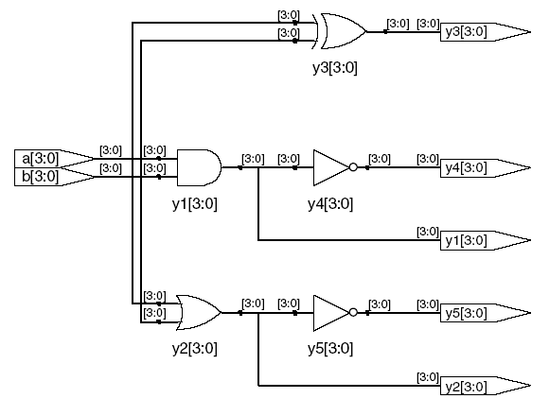
Bitwise Operators
module gates(input logic [3:0] a, b,
output logic [3:0] y1, y2, y3, y4, y5);
/* Five different two-input logic
gates acting on 4 bit busses */
assign y1 = a & b; // AND
assign y2 = a | b; // OR
assign y3 = a ^ b; // XOR
assign y4 = ~(a & b); // NAND
assign y5 = ~(a | b); // NOR
endmodule
// single line comment
/*…*/ multiline comment

Slide 13
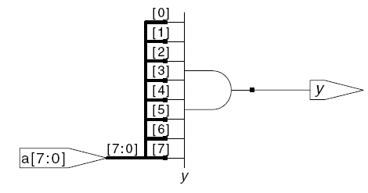
Reduction Operators
module and8(input logic [7:0] a,
output logic y);
assign y = &a;
// &a is much easier to write than
// assign y = a[7] & a[6] & a[5] & a[4] &
// a[3] & a[2] & a[1] & a[0];
endmodule

Slide 14
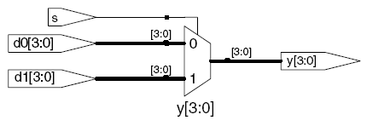
Conditional Assignment
module mux2(input logic [3:0] d0,
logic [3:0] d1,
input logic s,
output logic [3:0] y);
assign y = s ? d1 : d0;
endmodule
? : is also called a ternary operator because it
operates on 3 inputs: s, d1, and d0.

Slide 15
Internal Variables
module fulladder(input logic a, b, cin,
output logic s, cout);
logic p, g; // internal nodes
assign p = a ^ b;
assign g = a & b;
assign s = p ^ cin;
assign cout = g | (p & cin);
endmodule

Slide 16
Precedence
Highest
~ | NOT
*, /, % | mult, div, mod
+, - | add,sub
<<, >> | shift
<<<, >>> | arithmetic shift
<, <=, >, >= | comparison
==, != | equal, not equal
&, ~& | AND, NAND
^, ~^ | XOR, XNOR
|, ~| | OR, NOR
?: | ternary operator
Lowest

Slide 17
Numbers
Format: N'Bvalue
N = number of bits, B = base
N'B is optional but recommended (default is decimal)
Number | # Bits | Base | Decimal Equivalent | Stored
3'b101 | 3 | binary | 5 | 101
'b11 | unsized | binary | 3 | 00…0011
8'b11 | 8 | binary | 3 | 00000011
8'b1010_1011 | 8 | binary | 171 | 10101011
3'd6 | 3 | decimal | 6 | 110
6'o42 | 6 | octal | 34 | 100010
8'hAB | 8 | hexadecimal | 171 | 10101011
42 | Unsized | decimal | 42 | 00…0101010
Notes:
Fine lezione 10

Slide 18
Bit Manipulations: Example 1
assign y = {a[2:1], {3{b[0]}}, a[0], 6'b100_010};
// if y is a 12-bit signal, the above statement produces:
y = a[2] a[1] b[0] b[0] b[0] a[0] 1 0 0 0 1 0
// underscores (_) are used for formatting only to make
// it easier to read. SystemVerilog ignores them.
Y[0]=1’b1;
Y[1] = 1’b0;

Slide 19
Bit Manipulations: Example 2
SystemVerilog:
module mux2_8(input logic [7:0] d0, d1,
input logic s,
output logic [7:0] y);
mux2 lsbmux(d0[3:0], d1[3:0], s, y[3:0]);
mux2 msbmux(d0[7:4], d1[7:4], s, y[7:4]);
endmodule

Slide 20
Z: Floating Output
SystemVerilog:
module tristate(input logic [3:0] a,
input logic en,
output tri [3:0] y);
assign y = en ? a : 4'bz;
endmodule

Slide 21
SystemVerilog logic datatype
SystemVerilog logic datatype can assume 0, 1, z, and x values.
x indicates an invalid logic level. If a bus is simultaneously driven to 0 and 1 by two enabled tristate buffers (or other gates), the result is x, indicating contention.
If all the tristate buffers driving a bus are simultaneously OFF, the bus will float, indicated by z.
At the start of simulation, state nodes such as flip-flop outputs are initialized to an unknown state (x in SystemVerilog)

Slide 22
TRUTH TABLES WITH UNDEFINED AND FLOATING INPUTS
SystemVerilog sometimes can determine the output of logic operation despite some inputs being unknown.
& |  | A
 |  | 0 | 1 | z | x
B | 0 | 0 | 0 | 0 | 0
 | 1 | 0 | 1 | x | x
 | z | 0 | x | x | x
 | x | 0 | x | x | x
| |  | A
 |  | 0 | 1 | z | x
B | 0 | 0 | 1 | x | x
 | 1 | 1 | 1 | 1 | 1
 | z | x | 1 | x | x
 | x | x | 1 | x | x

